Slide 1
Workshop on C/C++
Day 1

Slide 2
Agenda
Introduction to ANSI C ,Namespaces
Structure of C program
Data Types and Operators
Types of Statements (Conditions and Loops)
Logical Programming (Exercises)

Slide 3
Introduction to ANSI C
The C programming language was developed in the Bell Labs of AT&T by an employee called Dennis Ritchie between 1969 and 1973 while working on Unix operating system.
He created this language using ALGOL, BCPL, and B the languages that were used before C was created.
American National Standards Institute (ANSI) in 1983, formed a committee to provide a comprehensive definition to the C language and thus came into existence the new ANSI C language with better features.

Slide 4
Namespaces in C
A namespace is a set of names of objects in a system.
It provides a way to disambiguate its objects from those with similar names in other namespaces.
The four namespaces are:
Tags for a struct/union/enum
Members of struct/union
Labels
Ordinary identifiers (termed objects in the C standard)

Slide 5
Namespaces in C
Thus in the following example all id identifier instances are different:
/* structure tag */
struct id {
int id; /* structure member */
};
/* Different structure */
struct id2 {
char id; /* structure member */
};
/* ordinary identifier */
id()
{
id: /* label */
}

Slide 6
Namespaces in C
Macro names and the names of macro formal arguments also live in separate namespaces within the preprocessor.
struct s1 {
int id;
} a;
struct s2 {
char id;
} b;
#define getid(x) ((x)->id)
main()
{
printf("%d %c", getid(a), getid(b));
}

Slide 7
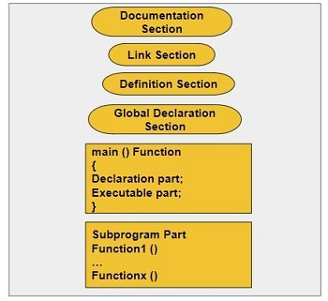
Structure of C program
The structure of C language consists of six important segments.
Documentation section
Link section
Definition section
Global declaration section
main () function
Subprogram section
Image Source - https://study.com/academy/lesson/ansi-c-history-formation-structure.html

Slide 8
Structure of C program
Documentation section
This part is sort of an introduction
to the program given as comments
which include the name of the
programmer and the name of the
program.
Image Source - https://study.com/academy/lesson/ansi-c-history-formation-structure.html

Slide 9
Structure of C program
Link section
This section provides instructions to
the compiler to functions from the
system library.
Image Source - https://study.com/academy/lesson/ansi-c-history-formation-structure.html

Slide 10
Structure of C program
Definition section
All constants are defined in
this section.
Image Source - https://study.com/academy/lesson/ansi-c-history-formation-structure.html

Slide 11
Structure of C program
Global declaration section
The variables that a programmer
uses more than once in the program
are declared here.
Image Source - https://study.com/academy/lesson/ansi-c-history-formation-structure.html

Slide 12
Structure of C program
main () function
It is the most important part of the
program as this function executes all
the instructions defined in the
subprogram section and the output
is generated.
Image Source - https://study.com/academy/lesson/ansi-c-history-formation-structure.html

Slide 13
Structure of C program
Subprogram section
A given program may have separate
subprograms or functions which
include a particular type of instruction
Image Source - https://study.com/academy/lesson/ansi-c-history-formation-structure.html

Slide 14
C Keywords and Identifiers
Character set
A character set is a set of alphabets,
letters and some special characters
that are valid in C language.
C accepts both lowercase and uppercase
alphabets as variables and functions.

Slide 15
C Keywords and Identifiers
C Keywords
Keywords are predefined, reserved words used in programming that have special meanings to the compiler.
Keywords are part of the syntax and they cannot be used as an identifier.
For example: int money;
Here, int is a keyword that indicates money is a variable of type int (integer).

Slide 16
C Keywords and Identifiers
C Identifiers
Identifier refers to name given to entities such as variables, functions, structures etc.
Identifiers must be unique.
They are created to give a unique name to an entity to identify it during the execution of the program.
For example: int money;
double accountBalance;
Here, money and accountBalance are identifiers.

Slide 17
C Variables
In programming, a variable is a container (storage area) to hold data.
To indicate the storage area, each variable should be given a unique name (identifier).
Variable names are just the symbolic representation of a memory location.
For example: int playerScore = 95;
Here, playerScore is a variable of int type.
Here, the variable is assigned an integer value 95.
The value of a variable can be changed, hence the name variable.

Slide 18
C Literals
Literals are data used for representing fixed values.
They can be used directly in the code.
For example: 1, 2.5, 'c' etc.

Slide 19
C Constants
If we want to define a variable whose value cannot be changed, we can use the const keyword.
This will create a constant.
For example, const double PI = 3.14;

Slide 20
C Data Types
In C programming, data types are declarations for variables.
This determines the type and size of data associated with variables.
For example, int myVar;
Here, myVar is a variable of int (integer) type. The size of int is 4 bytes.

Slide 21
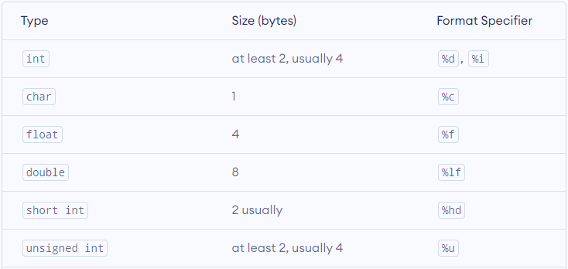
C Data Types

Slide 22
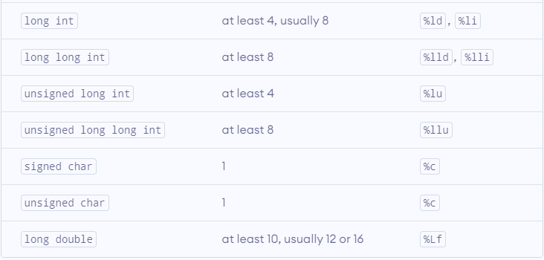
C Data Types

Slide 23
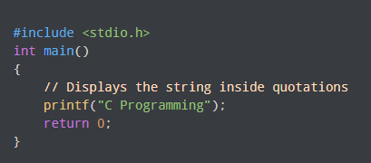
C Input Output (I/O)
C Output
In C programming, printf() is one
of the main output function.
The function sends formatted output
to the screen.

Slide 24
C Input Output (I/O)
How does this program work?
All valid C programs must contain the main() function. The code execution begins from the start of the main() function.
The printf() is a library function to send formatted output to the screen. The function prints the string inside quotations.
To use printf() in our program, we need to include stdio.h header file using the #include <stdio.h> statement.
The return 0; statement inside the main() function is the "Exit status" of the program. It's optional.

Slide 25
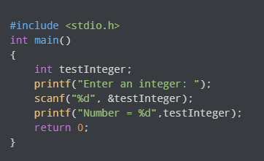
C Input Output (I/O)
C Input
In C programming, scanf() is one of
the commonly used function to take
input from the user.
The scanf() function reads formatted
input from the standard input such as
keyboards.

Slide 26
C Input Output (I/O)
Here, we have used %d format specifier inside the scanf() function to take int input from the user.
When the user enters an integer, it is stored in the testInteger variable.
We have used &testInteger inside scanf().
It is because &testInteger gets the address of testInteger, and the value entered by the user is stored in that address.

Slide 27
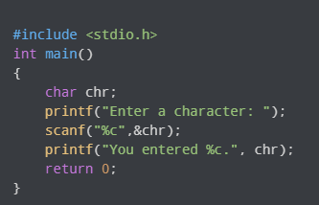
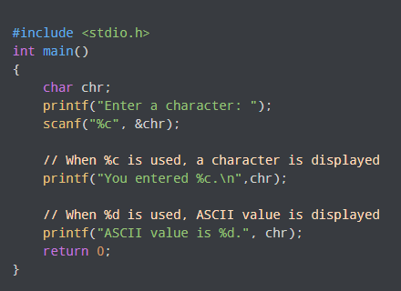
C Input Output (I/O)
C Character I/O
When a character is entered by the
user in the above program, the character
itself is not stored. Instead, an integer
value (ASCII value) is stored.
And when we display that value using %c
text format, the entered character is displayed.
If we use %d to display the character, it's
ASCII value is printed.

Slide 28
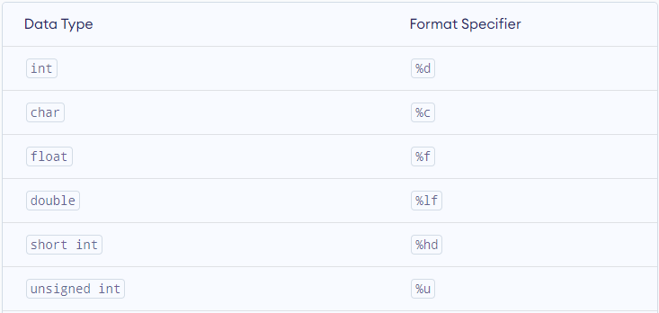
Format Specifiers for I/O

Slide 29
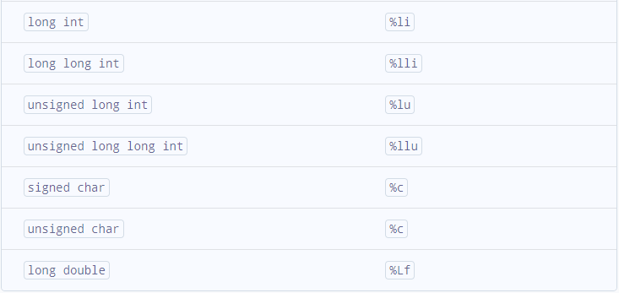
Format Specifiers for I/O

Slide 30
C Operators
An operator is a symbol that operates on a value or a variable.
Arithmetic Operators
Increment and Decrement Operators
Assignment Operators
Relational Operators
Logical Operators
Bitwise Operators

Slide 31
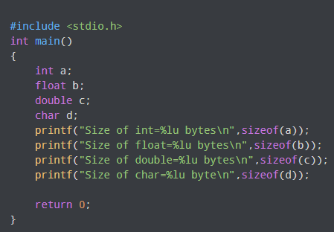
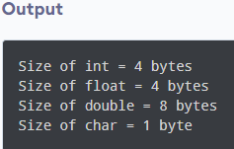
C Operators
The sizeof operator
The sizeof is a unary operator that returns the size of data (constants, variables, array, structure, etc).

Slide 32
C if...else Statement
How if...else statement works?
If the test expression is evaluated to true,
statements inside the body of if are executed.
statements inside the body of else are skipped from execution.
If the test expression is evaluated to false,
statements inside the body of else are executed
statements inside the body of if are skipped from execution.

Slide 33
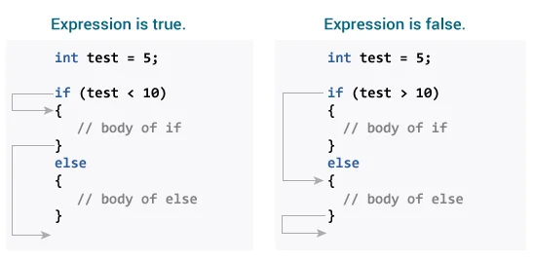
C if...else Statement

Slide 34
C for Loop
In programming, a loop is used to repeat a block of code until the specified condition is met.
C programming has three types of loops:
for loop
while loop
do...while loop

Slide 35
C for Loop
How for loop works?
The initialization statement is executed only once.
Then, the test expression is evaluated. If the test expression is evaluated to false, the for loop is terminated.
However, if the test expression is evaluated to true, statements inside the body of the for loop are executed, and the update expression is updated.
Again the test expression is evaluated.
This process goes on until the test expression is false. When the test expression is false, the loop terminates.

Slide 36
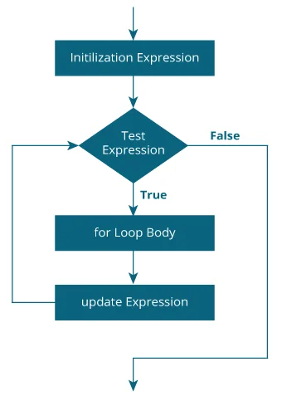
C for Loop
for loop Flowchart

Slide 37
C while loop
How while loop works?
The while loop evaluates the testExpression inside the parentheses ().
If testExpression is true, statements inside the body of while loop are executed. Then, testExpression is evaluated again.
The process goes on until testExpression is evaluated to false.
If testExpression is false, the loop terminates (ends).

Slide 38
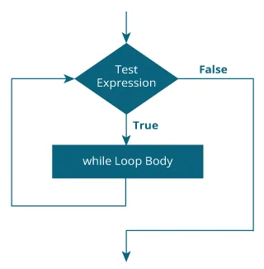
C while loop
Flowchart of while loop

Slide 39
C do...while loop
The do..while loop is similar to the while loop with one important difference.
The body of do...while loop is executed at least once.
Only then, the test expression is evaluated.

Slide 40
C do...while loop
How do...while loop works?
The body of do...while loop is executed once. Only then, the testExpression is evaluated.
If testExpression is true, the body of the loop is executed again and testExpression is evaluated once more.
This process goes on until testExpression becomes false.
If testExpression is false, the loop ends.

Slide 41
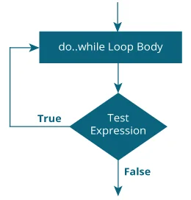
C do...while loop
Flowchart of do...while Loop

Slide 42
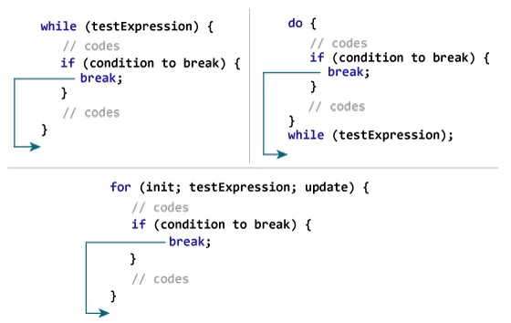
C break and continue
The break statement ends the loop
immediately when it is encountered.
How break statement works?

Slide 43
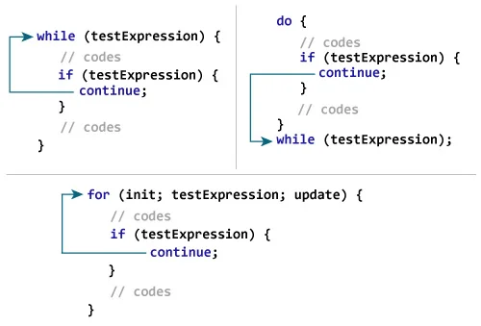
C break and continue
The continue statement skips the
current iteration of the loop and
continues with the next iteration.
How continue statement works?

Slide 44
C switch Statement
The switch statement allows us to execute one code block among many alternatives.
You can do the same thing with the if...else..if ladder.
However, the syntax of the switch statement is much easier to read and write.

Slide 45
C switch Statement
How does the switch statement work?
The expression is evaluated once and compared with the values of each case label.
If there is a match, the corresponding statements after the matching label are executed.
If there is no match, the default statements are executed.
If we do not use the break statement, all statements after the matching label are also executed.
The default clause inside the switch statement is optional.

Slide 46
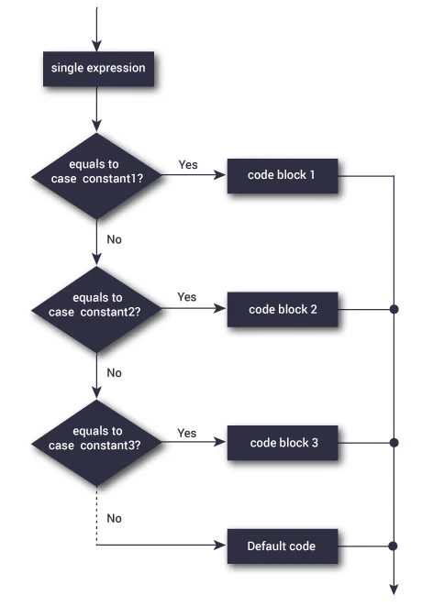
C switch Statement
switch Statement Flowchart

Slide 47


Slide 48

Please contact
Foundation for Innovation and Collaborative
Education
mentor@fice.in
www.fice.in
Please contact
Foundation for Innovation and Collaborative
Education
info@fice.in
mentor@fice.in
Notes:
Here are the lessons we are going to learn today.

